Slide 1
Design and Analysis of Algorithms (UE20CS251)
Unit II - Decrease-and-Conquer
Mr. Channa Bankapur
channabankapur@pes.edu

Slide 2
Sum of the elements of an array using
Brute Force approach.
Algorithm Sum(A[0..n-1])
//Sum(A[0..n-1]) = A[0] + A[1] + … + A[n-1]
//Input: Array A having n numbers
//Output: Sum of n numbers in the array A
sum ← 0
for i ← 1 to n
sum ← sum + A[i]
return sum
C(n) = n
T(n) ∈ 𝚹(n)

Slide 3
Sum of the elements of an array using
Decrease-and-Conquer approach.
Algorithm Sum(A[0..n-1])
//Sum(A[0..n-1]) = Sum(A[0..n-2]) + A[n-1]
//Input: Array A having n numbers
//Output: Sum of n numbers in the array A
if (n = 0) return 0
return Sum(A[0..n-2]) + A[n-1]
C(n) = C(n-1) + 1, C(1) = 1
T(n) ∈ 𝚹(n)

Slide 4
Brute Force:
Sum(A[0..n-1]) = A[0] + A[1] + … + A[n-1]
T(n) ∈ 𝚹(n)
Decrease-and-Conquer:
Sum(A[0..n-1]) = Sum(A[0..n-2]) + A[n-1]
C(n) = C(n-1) + 1, C(1) = 1
T(n) ∈ 𝚹(n)

Slide 5
Finding a^{n} using Brute Force approach.
Algorithm Power(a, n)
//Finds a^{n} = a*a*...a (n times)
//Input: a ∈ R and n ∈ N
//Output: a^{n}
p ← 1
for i ← 1 to n
p ← p * a
return p
C(n) = n
T(n) ∈ 𝚹(n)

Slide 6
Finding a^{n} using Decrease-and-Conquer approach.
Algorithm Power(a, n)
//Finds a^{n} = a^{n-1} * a
//Input: a ∈ R and n ∈ N
//Output: a^{n}
if (n = 0) return 1
return Power(a, n-1) * a
C(n) = C(n-1) + 1 , C(0) = 0
T(n) ∈ 𝚹(n)
This approach is Decrease-by-a-constant-and-Conquer.
Can we solve it by Decrease-by-a-constant-factor-and-Conquer?

Slide 7
Finding a^{n} using Decrease-by-a-constant-factor-and-Conquer approach.
Algorithm Power(a, n)
//Finds a^{n} = (a^{⌊n/2⌋})² * a^{n mod 2}
//Input: a ∈ R and n ∈ N
//Output: a^{n}
if (n = 0) return 1
p ← Power(a, ⌊n/2⌋)
p ← p * p
if (n is odd) p ← p * a
return p
C(n) = C(n/2) + 2
T(n) ∈ 𝚹(log n)

Slide 8
Finding a^{n} using different approaches.
Brute-Force approach in Θ(n)
a^{n} = a * a * … a (n times)
Decrease-by-a-constant-and-Conquer in Θ(n)
a^{n} = a^{n-1} * a, a⁰=1
Decrease-by-a-constant-factor-and-Conquer in Θ(log n)
a^{n} = (a^{⌊n/2⌋})² * a^{n mod 2}, a⁰ = 1
a^{n} = (a^{n/2})² when n is even
a^{n} = a*(a^{(n-1)/2})² when n is odd and
a⁰ = 1

Slide 9
Decrease-and-Conquer:
Solve a smaller instance of the problem.
Extend the solution of the smaller instance to obtain solution to the original instance.
Also referred to as inductive or incremental approach.

Slide 10
Variants of Decrease-and-Conquer:
Decrease-by-a-constant-and-Conquer
a^{n} = a^{n-1} * a
Sum(a_{0..n-1}) = Sum(a_{0..n-2}) + a_{n-1}
Decrease-by-a-constant-factor-and-Conquer
a^{n} = (a^{n/2})² when n is even
a^{n} = a*(a^{(n-1)/2})² when n is odd and
a¹ = a, a⁰ = 1
Binary Search
Decrease-by-variable-size-and-Conquer
gcd(m, n) = gcd(n, m mod n), and gcd(m, 0) = m

Slide 11
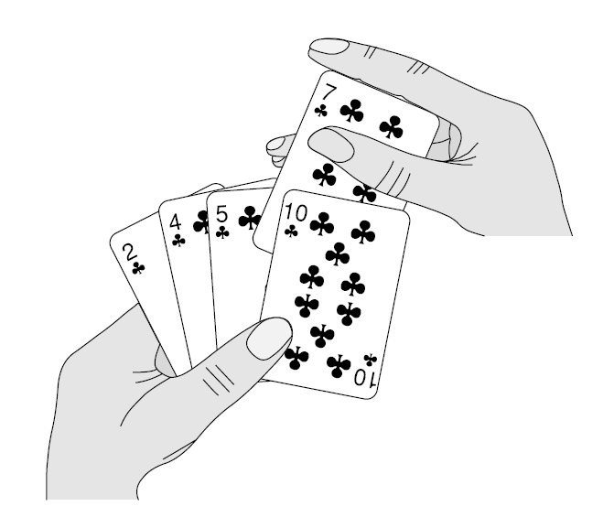
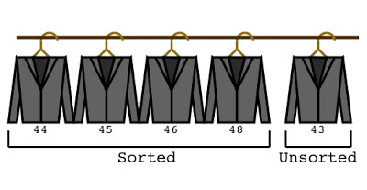
Insertion Sort:

Slide 12
Insertion Sort: To sort an array A[0..n-1], sort A[0..n-2] and then insert A[n-1] in its proper place among the sorted A[0..n-2]. It’s a Decrease-by-a-constant-and-Conquer approach.
Algorithm InsertionSortRecursive( A[0..n-1] )
if (n <= 0) return
InsertionSortRecursive(A[0..n-2])
val = A[n-1]
hole = n-1
while(hole > 0 and A[hole - 1] > val)
A[hole] = A[hole - 1]
hole = hole - 1
A[hole] = val

Slide 13
Insertion Sort: To sort an array A[0..n-1], sort A[0..n-2] and then insert A[n-1] in its proper place among the sorted A[0..n-2].
The approach is Decrease-by-a-constant-and-Conquer.
The algorithm is usually implemented bottom-up (non-recursively).
Example: Sort 6, 4, 1, 8, 5, 5
6 | 4 1 8 5 5
4 6 | 1 8 5 5
1 4 6 | 8 5 5
1 4 6 8 | 5 5
1 4 5 6 8 | 5
1 4 5 5 6 8

Slide 14
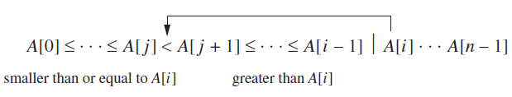
Algorithm InsertionSort(A[0..n-1])
for size = 2 to n
val = A[size - 1]
hole = size - 1
while(hole > 0 and A[hole - 1] > val)
A[hole] = A[hole - 1]
hole = hole - 1
A[hole] = val

Slide 15
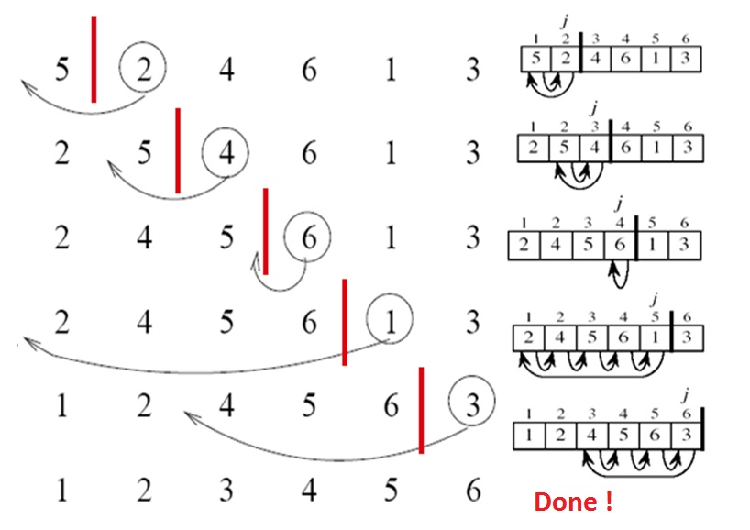

Slide 16
Time efficiency
Basic operation: (A[j-1] > temp)
C_{worst}(n) = ? ∈ Θ(?)
C_{best}(n) = ? ∈ Θ(?)
C_{avg}(n) = ? ∈ Θ(?)
Space complexity ?
Stable sorting ?

Slide 17
Time efficiency
Basic operation: (A[j-1] > temp)
C_{worst}(n) = 1 + 2 + 3 + … + n - 1 = n (n - 1) / 2 ∈ Θ(n²)
C_{best}(n) = n - 1 ∈ Θ(n)
C_{avg}(n) ≈ n²/4 ∈ Θ(n²)
Space complexity ?
Stable sorting ?
Fast on nearly sorted arrays
Best elementary sorting algorithm overall
Often used in Quicksort implementations
Binary insertion sort

Slide 18
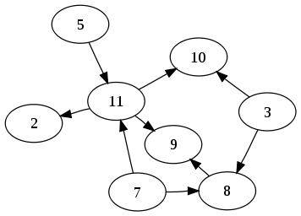
Directed cycle:
It is a cycle or circuit in a digraph.
DAG (directed acyclic graph):
A digraph having no directed cycle.
Topological Sorting:
(aka Toposort, Topological Ordering)
What do you know about Topological Sorting from the course in Discrete Math?

Slide 19
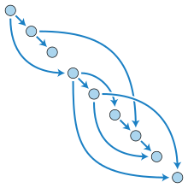
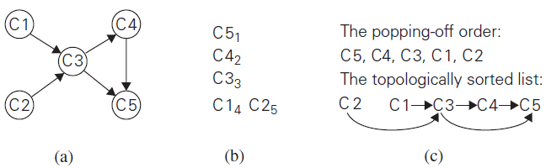
Topological Sorting: is listing vertices of a directed graph in such an order that for every edge in the graph, the vertex where the edge starts is listed before the vertex where the edge ends.
A digraph has a topological sorting iff it is a dag.

Slide 20
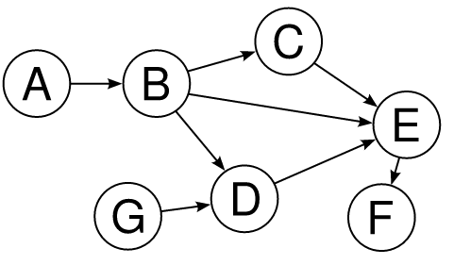
Finding a Topological Sorting of the vertices of a dag:
Source-removal algorithm
DFS-based algorithm

Slide 21
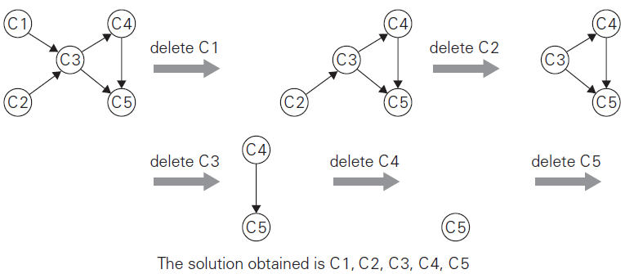
Source-removal algorithm for finding Topological Sorting

Slide 22
Algorithm SourceRemoval_Toposort(V, E)
L ← Empty list that will contain the sorted vertices S ← Set of all vertices with no incoming edges while S is non-empty do remove a vertex v from S add v to tail of L for each vertex m with an edge e from v to m do remove edge e from the graph if m has no other incoming edges then insert m into S if graph has edges then return error (not a DAG) else return L (a topologically sorted order)

Slide 23
Find a Topological Sort of the following dag using
Source-removal algorithm

Slide 24
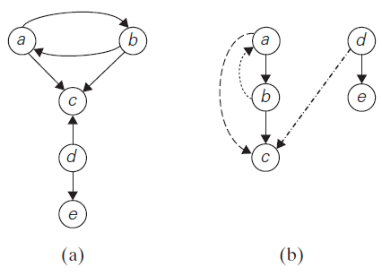
Draw a DFS forest for
the given directed graph.

Slide 25
(a) DiGraph
(b) DFS Forest
Tree edges
Back edges
Forward edges
Cross edges

Slide 26
DFS-based algorithm for finding Topological Sorting

Slide 27
Algorithm DFS_Toposort(V, E)
L ← Empty list that will contain the sorted vertices
for each vertex v in V
v.mark ← 0 for each vertex v in V do if(v.mark = 0) visit(v, L) return L
Procedure visit(vertex v, List L)
v.mark ← 1 for each vertex m with an edge (v, m) do if(m.mark = 0) visit(m) add v at head of L

Slide 28
Algorithm DFS_Toposort(V, E)
L ← Empty list that will contain the sorted vertices
for each vertex v in V
mark(v) ← 0, instack(v) ← 0 for each vertex v do if(mark(v) = 0) visit(v, L)
return L
Procedure visit(vertex v, List L)
mark(v) ← 1, instack(v) ← 1 for each vertex m with an edge (v, m) do if(mark(v) = 0) visit(m)
else if(instack(m) = 1) return ERROR_DAG add v at head of L
instack(v) ← 0

Slide 29
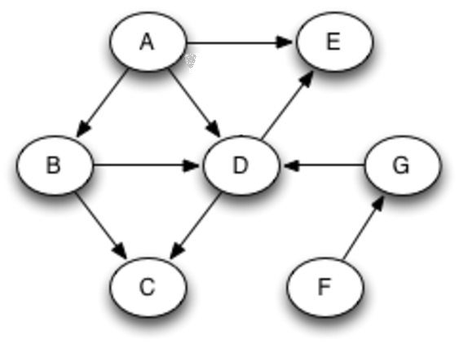
Topological Sorting of the vertices using
Source-removal algorithm
DFS-based algorithm

Slide 30
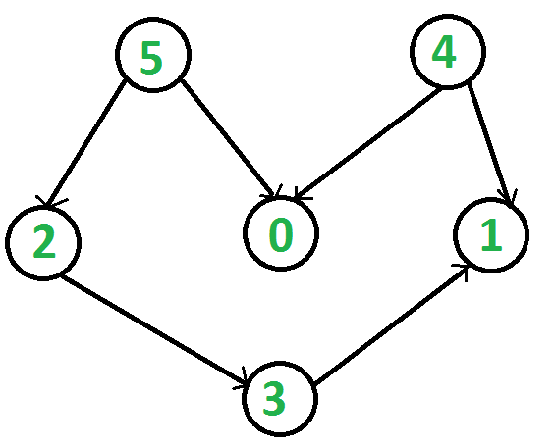
Topological Sorting of the vertices using
Source-removal algorithm
DFS-based algorithm

Slide 31
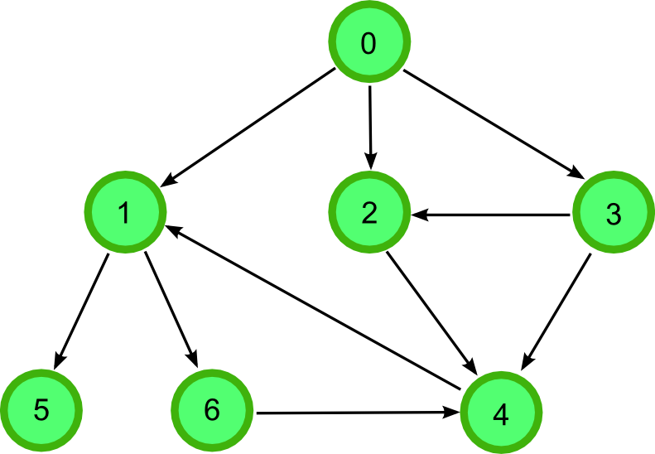
Topological Sorting of the vertices using
Source-removal algorithm
DFS-based algorithm

Slide 32
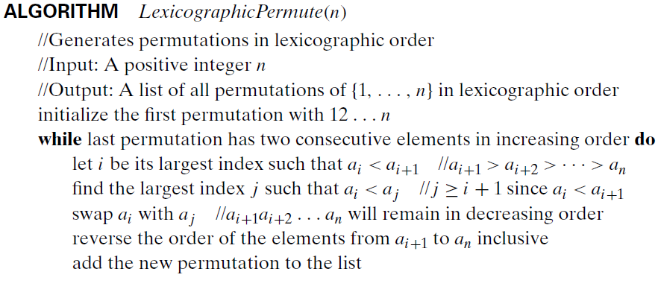
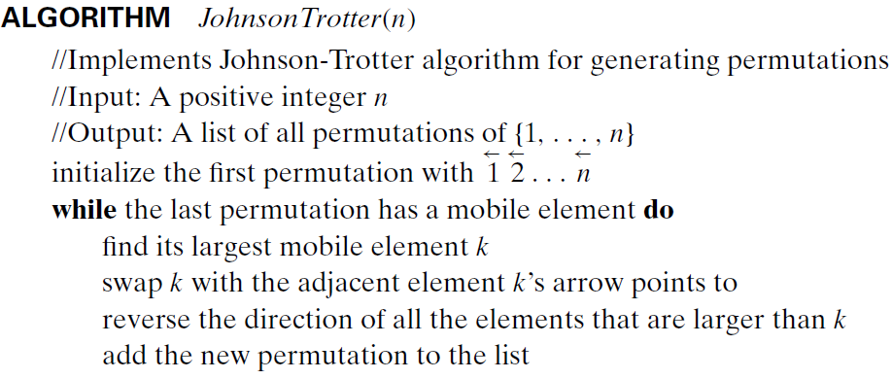
Generating Permutations:
Lexicographic
Order
Decrease-and-
Conquer

Slide 33
Generating Permutations:
123
132
213
231
312
321
Lexicographic order
the order in which they would be listed in a dictionary if the digits were interpreted as letters/characters.
Decrease-and-Conquer
Solve it for input size of (n-1) and hence for n.

Slide 34
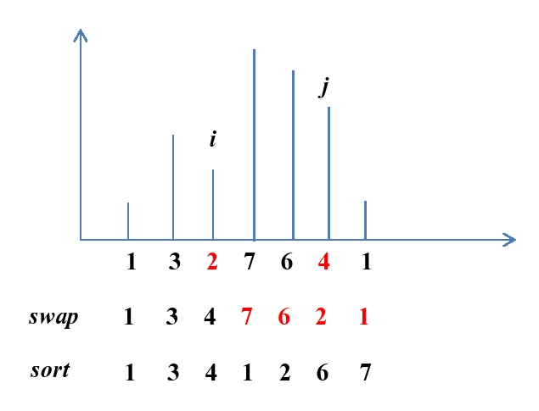

Slide 35
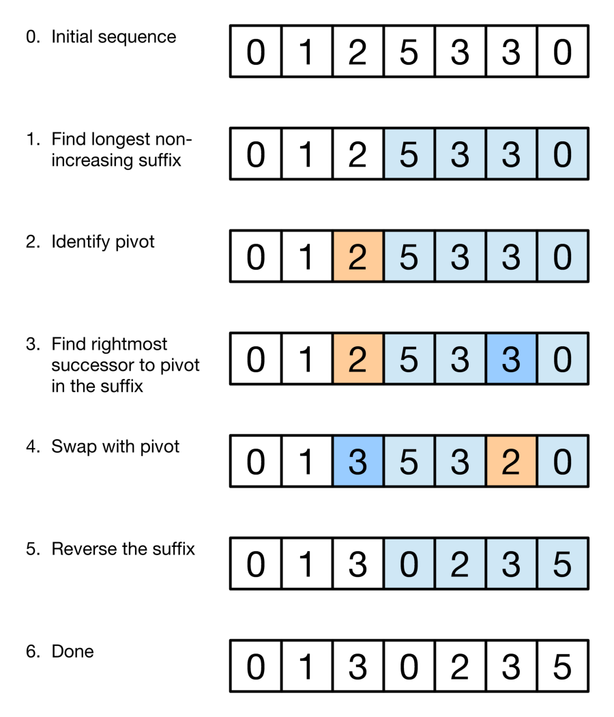

Slide 37
Generating Permutations by Decrease-and-Conquer
Solve it for input size of (n-1) and hence for n.
Basis Step: There is only one permutation for 1 symbol
Hypothesis: Assume we know how to generate permutations for (n-1) symbols.
Induction: Extend it to generate permutations for n symbols.

Slide 38
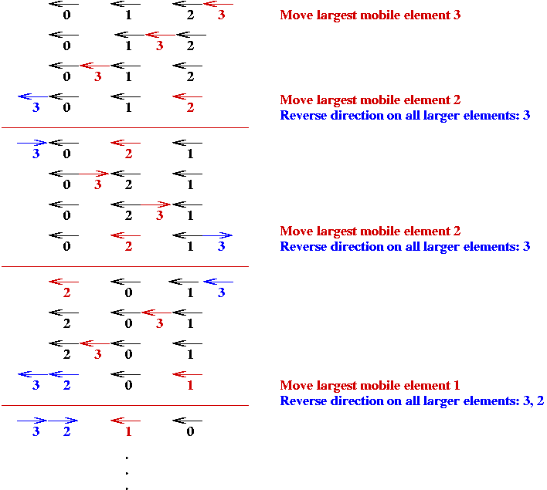
Johnson-
Trotter algorithm to generate permutations

Slide 39
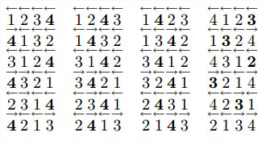
Johnson-Trotter algorithm
to generate permutations

Slide 41
Generating Subsets:
Knapsack problem needed to find the most valuable subset of items that fits a knapsack of a given capacity.
Powerset: set of all subsets of a set. Set A={1, 2, ..., n} has 2^{n} subsets.
Generate all subsets of the set A={1, 2, ..., n}.
Any decrease-by-one idea?
# of subsets of { } = 2⁰ = 1, which is { } itself
Suppose, we know how to generate all subsets of {1,2,...,n-1}
Now, how can we generate all subsets of {1,2,...,n} ?

Slide 42
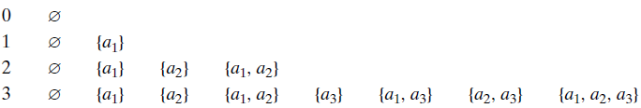
Generating Subsets:
All subsets of {1,2,...,n-1}: 2^{n-1} such subsets
All subsets of {1,2,...,n}:
2^{n-1} subsets of {1,2,...,n-1} and
another 2^{n-1} subsets of {1,2,...,n-1} having ‘n’ with them.
That adds up to all 2^{n} subsets of {1,2,...,n}

Slide 43
Alternate way of Generating Subsets:
Knowing the binary nature of either having nth element or not, any idea involving binary numbers itself?
One-to-one correspondence between all 2^{n} bit strings b₁b₂...b_{n}
and 2^{n} subsets of {a₁, a₂, …, a_{n}}.
Each bit string b₁b₂...b_{n} could correspond to a subset.
In a bit string b₁b₂...b_{n} , depending on whether b_{i} is 1 or 0, a_{i} is in the subset or not in the subset.

Slide 44
Generating Subsets in Squashed order:
Squashed order: any subset involving a_{j} can be listed only after all the subsets involving a₁, a₂, …, a_{j-1}
Both of the previous methods does generate subsets in squashed order.

Slide 45
Generating Subsets in Squashed order:
Squashed order: any subset involving a_{j} can be listed only after all the subsets involving a₁, a₂, …, a_{j-1}
Can we do it with minimal change in bit-string (actually, just one-bit change to get the next bit string)? This would mean, to get a new subset, just change one item (remove one item or add one item).
Binary reflected gray code:
000 001 011 010 110 111 101 100

Slide 46
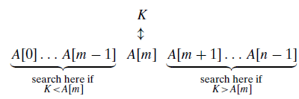
Decrease-by-a-Constant-Factor Algorithms:
Finding a^{n}
a^{n} = (a^{⌊n/2⌋})² * a^{n mod 2}
a^{n} = (a^{n/2})² when n is even
a^{n} = a*(a^{(n-1)/2})² when n is odd and
a¹ = a, a⁰ = 1
Binary Search:

Slide 47
Decrease-by-a-Constant-Factor Algorithms:
Algorithm BinarySearchRec(A[0..n-1], K)
if(n <= 0)
return -1
m = ⌊n/2⌋
if(k = A[m])
return m
if(k < A[m])
return BinarySearchRec(A[0..m-1], K)
else
return BinarySearchRec(A[m+1..n-1], K)

Slide 48
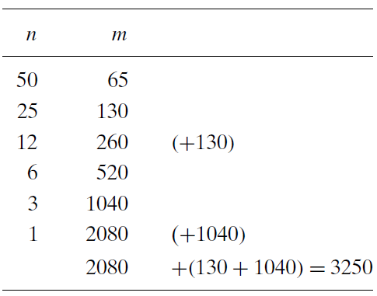
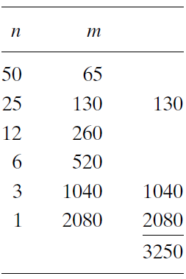



Multiplication à la Russe:
(aka Russian peasant method)

Slide 49
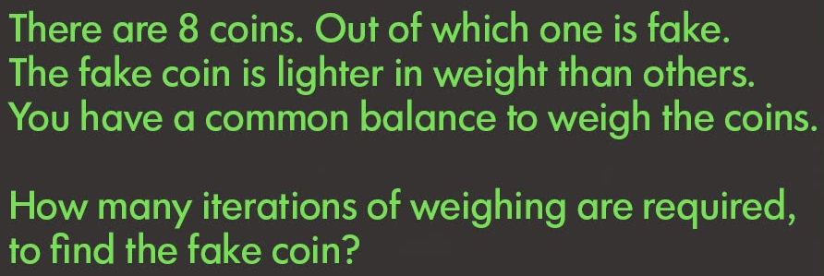
A puzzle circulated in WhatsApp groups
Fake-Coin Problem: There are n coins, which appear identical except that one of them is fake. The fake coin is lighter than the genuine ones. There is a balance scale but there are no weights; the scale can tell whether two sets of coins weigh the same and, if not, which of the two sets is heavier (but not by how much). Design an efficient algorithm for detecting the fake coin. Objective is to minimize the number of iterations of weighing.

Slide 50
Decrease-by-a-Constant-Factor Algorithms:
Fake-Coin Problem:
Decrease-by-a-factor of 2 algorithm
For 8 coins, it takes 3 iterations.
log₂ n iterations of weighing
log₂ 1 trillion = 40
Decrease-by-a-factor of 3 algorithm
For 9 coins, it takes 2 iterations.
For 8 coins, it takes 2 iterations.
log₃ n iterations of weighing
log₃ 1 trillion = 26

Slide 51
A puzzle circulated in WhatsApp groups
10 people standing in a circle in an order from 1 to 10.
No. 1 has a sword.
He kills the next person (i.e. no. 2) and gives sword to the following person (i.e. no. 3). Every time the person holding the sword kills the next alive person in the circle and gives the sword to the following alive person. It continues till only one person survives. Which one survives in the end? The problem is to determine the survivor’s number.

Slide 52
A puzzle circulated in WhatsApp groups
Answer for the previous one is 5. That is, 5th person survives.
What if there are 100 people in the circle to start with.
100 people standing in a circle in an order from 1 to 100.
No. 1 has a sword.
He kills the next person (i.e. no. 2) and gives sword to the following person (i.e. no. 3). Every time the person holding the sword kills the next alive person in the circle and gives the sword to the following alive person. It continues till only one person survives. Which one survives in the end? The problem is to determine the survivor’s number J(n).

Slide 53
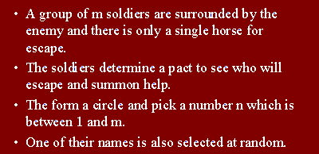
Josephus Problem:
Let n people be numbered from 1 to n stand in a circle. Starting the count from 1, we eliminate every second person until only one survivor is left. The problem is to determine the survivor’s number J(n).

Slide 54
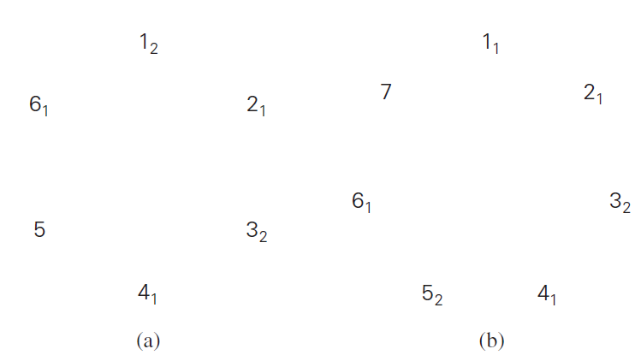
Josephus Problem:
The problem is to determine the survivor’s number J(n).

Slide 55
Josephus Problem:
1 1 5 5
2 3 9
3 5
4 7
5 9
6
7
8
9
10
1 3 7 7
2 5 11
3 7
4 9
5 11
6
7
8
9
10
11
1 1 1 9
2 3 5
3 5 9
4 7
5 9
6 11
7
8
9
10
11
12

Slide 56


Josephus Problem:
The problem is to determine the survivor’s number J(n).

Slide 57
Take just a step at a time and reduce your problem size!
</ Decrease-n-Conquer >

